Slide 1
Topological sorting

Slide 2
Real life situation
Let’s say, you're making Pasta.
Dependencies:
You have to chop veggies, before you sauté them.
Chop veggies → Sauté veggies.
You must boil pasta, before you mix it with sauce.
Boil Pasta → Mix with sauce.
You can‘t serve the meal until everything is cooked
Mix with sauce → Serve meal
Just like cooking has a set of steps you must follow in the right order, topological sort helps computers follow the right order of tasks based on what depends on what

Slide 3
Topological sorting
It is a linear ordering of the vertices of a Directed acyclic graph (DAG), such that for every directed edge u→v vertex u appears before v in the ordering.
DAG (Directed Acyclic Graph)
A DAG is a graph where:
All edges have a direction (from one node to another), and
There are no cycles — you can’t return to the same node by following the edges.

Slide 4
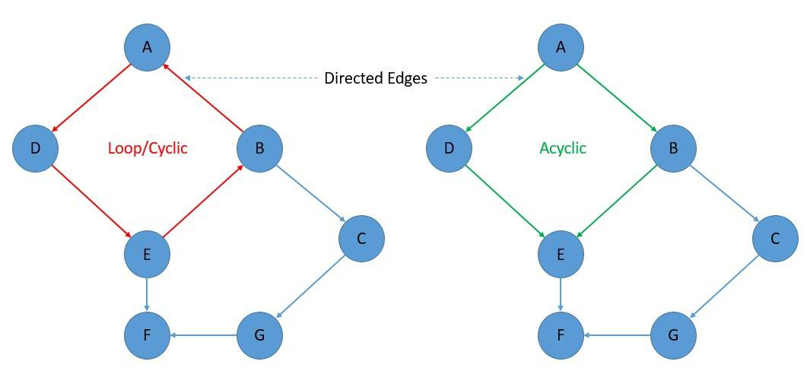

Slide 5
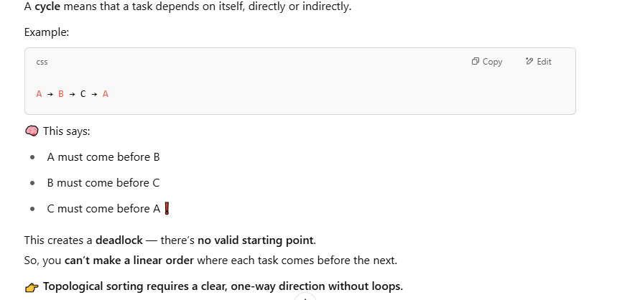
Why it only works on DAGs?

Slide 6
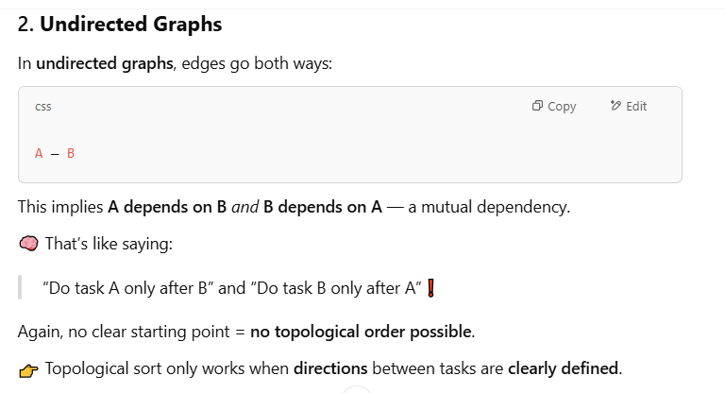
Why it only works on DAGs?

Slide 7
How it works?

Slide 8
Two techniques
Kahn‘s Algorithm:
Kahn's Algorithm is an efficient method used for topological sorting of a Directed Acyclic Graph (DAG).
The algorithm is based on BFS and utilize the concept of in-degree to determine the order of nodes and uses a queue to process the nodes and ensures that the final order respects all dependencies.

Slide 9
Steps of Kahn's Algorithm for Topological Sort:
Step 0: Find indegree for all nodes.
Step 1: Identify a node with no incoming edges.
Step 2: Remove the node from the graph and add it to the ordering.
Step 3: Remove the node’s out-going edges from the graph.
Step 4: Decrement the indegree where connected edges were deleted.
Step 5: Repeat Steps 1 to 4 till there are no nodes left with zero indegree.
Step 6: Check if all elements are present in the sorted order.
Step 7: If the result of Step 6 is true, we have the sorted order. Else, no topological ordering exists.
‍Step 8: Exit.

Slide 10
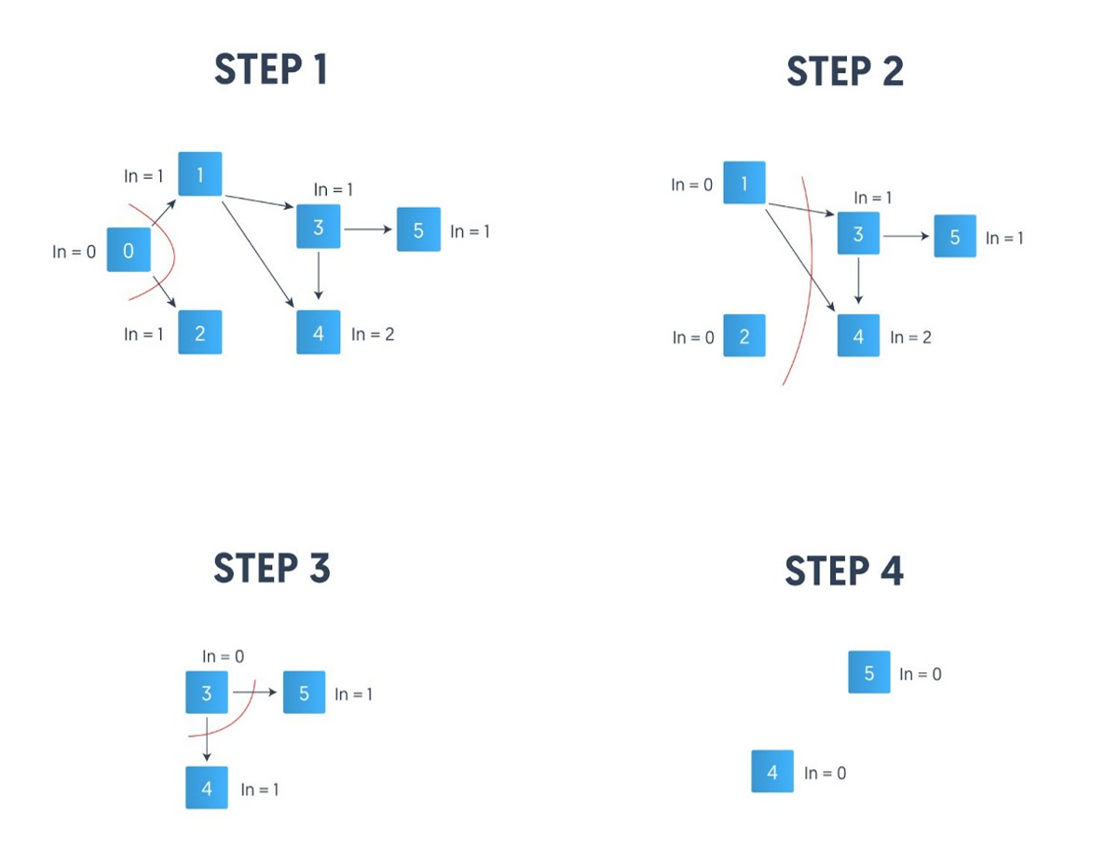
Edges: {0, 1}, {0, 2}, {1, 3}, {1, 4}, {3, 4}, {3, 5}

Slide 11
DFS ( Depth-First search)
DFS (Depth-First Search) is a graph traversal technique where you:
Start at a node,
Explore as far as possible along each branch before backtracking.
In topological sorting, you want to order tasks (or nodes) such that every dependency comes before the dependent. DFS helps with that by visiting all the dependencies first and then pushing the current node to the result.

Slide 12
Steps of DFS-Based Topological Sort:
Mark the current node as visited.
2. Visit all its neighbors recursively.
3. After visiting all neighbors, push the current node to a stack (or list).
4. Reverse the stack at the end to get the topological order.

Slide 13
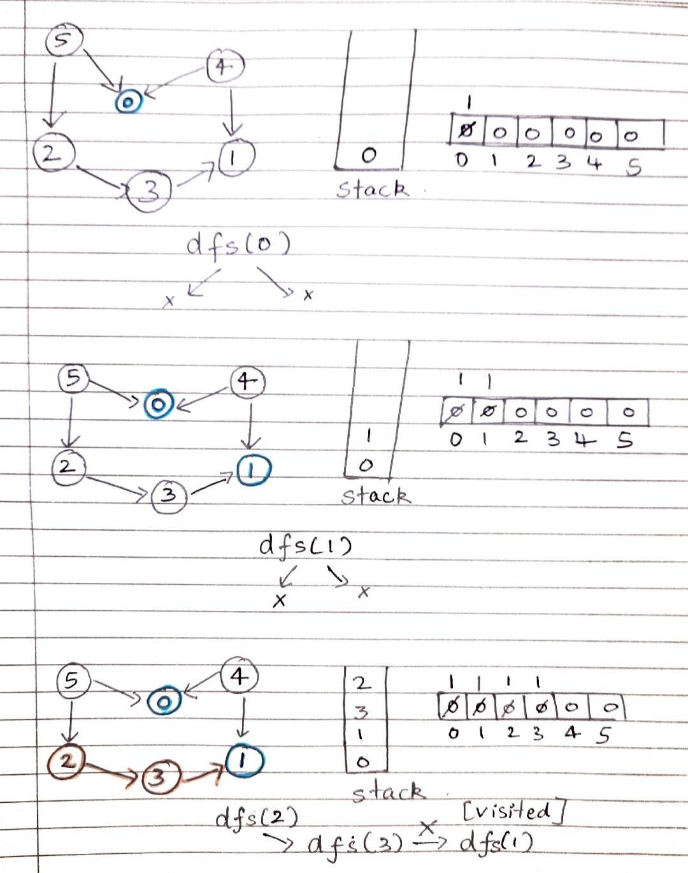
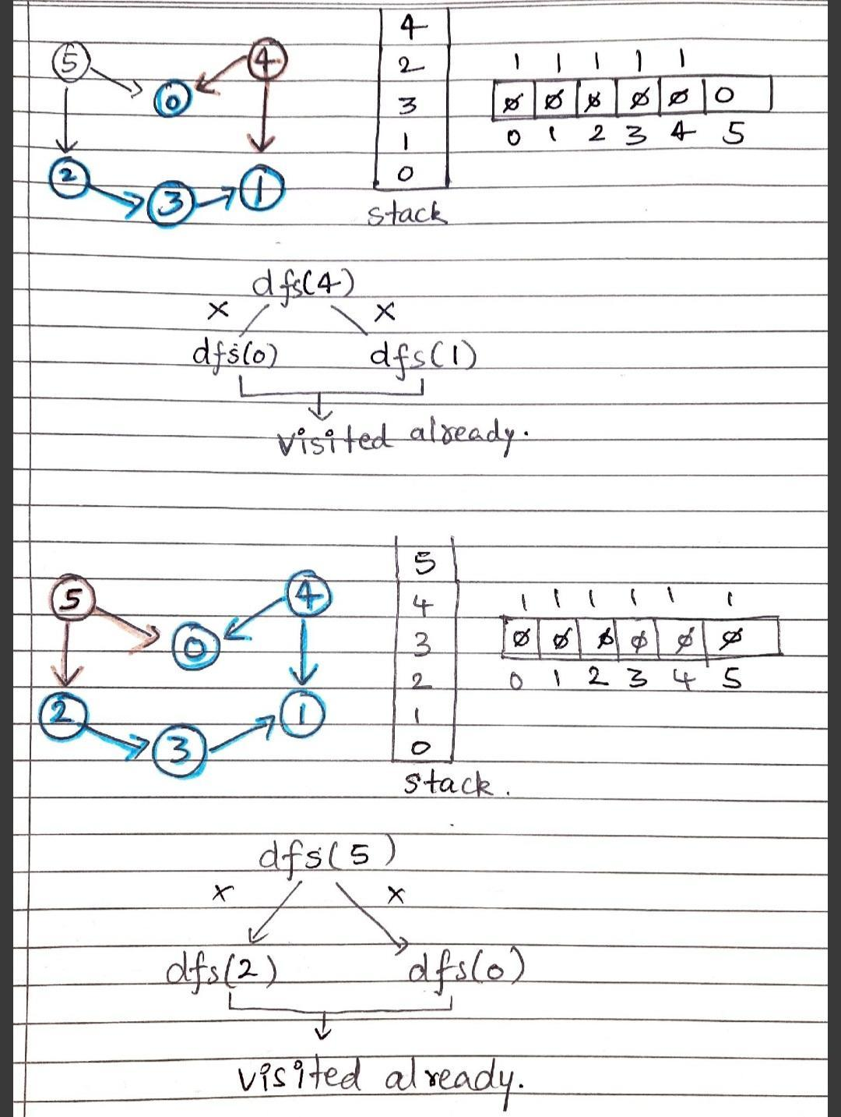

Slide 14
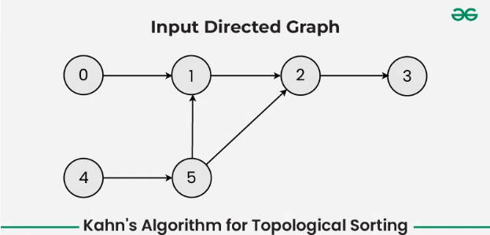
Activity 1: solve this using Kahn’s Algorithm:

Slide 15
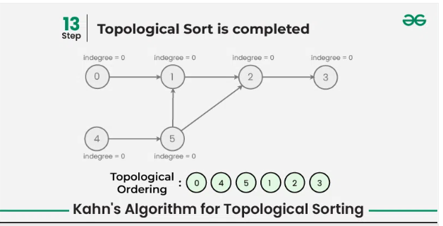
Answer:

Slide 16
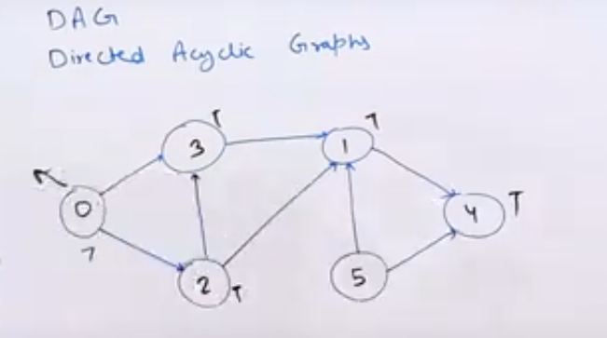
Solve this using DFS:

Slide 17
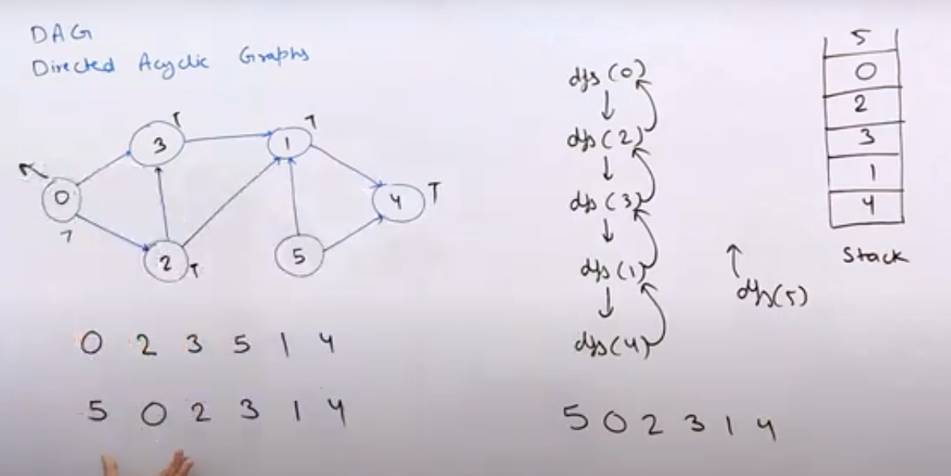
Answer:

